Slide 1

Transcription-Coupled DNA Repair and DNA Damage Surveillance in Health
Instructor: Dr.Eslami
presented by: Zeynab saraqi Noqani,
Minoo Javadi , Parmida Hefzosehe

Slide 2
Importance of DNA Repair
Cellular DNA is continuously exposed to damage caused by:
Endogenous factors
Environmental agents
If DNA lesions are not properly repaired, they may lead to:
Transcriptional disruption
Mutation accumulation
Genomic instability
Cancer and neurodegenerative disorders

Slide 3
Sources of DNA Damage
1
2
Endogenous Sources
Exogenous Sources
1- Reactive oxygen species (ROS)
2-Replication errors
3-Deamination
4-Alkylation
1-Ultraviolet (UV) radiation
2-Ionizing radiation
3-Chemical agents
4- Anticancer drugs

Slide 4
Transcription-Blocking Lesions
DNA lesions:
Stall RNA Polymerase II
Disrupt transcription elongation
Examples
.
UV-induced thymine dimers 6-4 photoproducts
Cisplatin-DNA adducts
DNA-protein crosslinks
.
.
.

Slide 5
Stalling of RNA Polymerase II
Consequences of RNA Polymerase II Stalling
When RNA Polymerase II becomes stalled:
Transcription is interrupted
Transcription stress is induced
DNA repair pathways are activated
TC-NER proteins are recruited
.

Slide 6
Transcription-Coupled NER (TC-NER)
.
.
.
.
.
.
What is TC-NER?
Transcription-Coupled Nucleotide Excision Repair (TC-NER) is a specialized branch of:
Nucleotide Excision Repair (NER)
that specifically repairs:
DNA lesions located in actively transcribed genes
.
.
.
.
.
.
.

Slide 7
Damage Recognition
Key Concept of the Study
RNA Polymerase II itself functions as a DNA damage sensor.
When the polymerase stalls at a lesion:
The TC-NER pathway is initiated

Slide 8
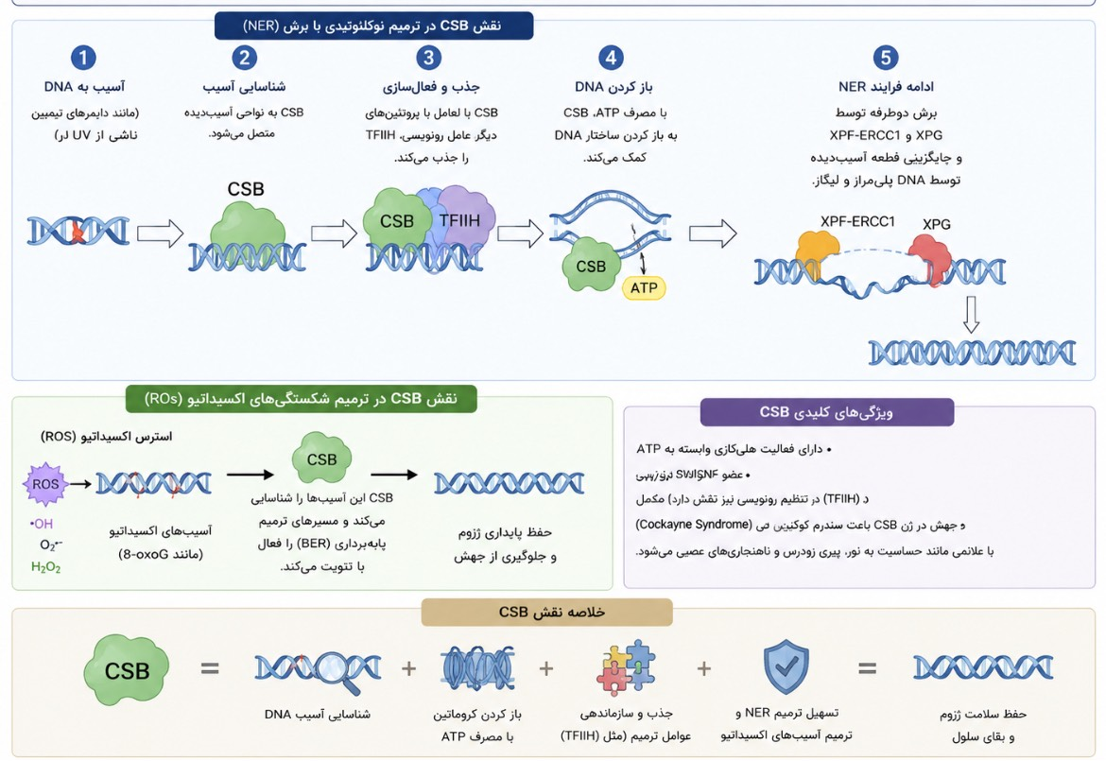
Role of CSB
.
.

Slide 9
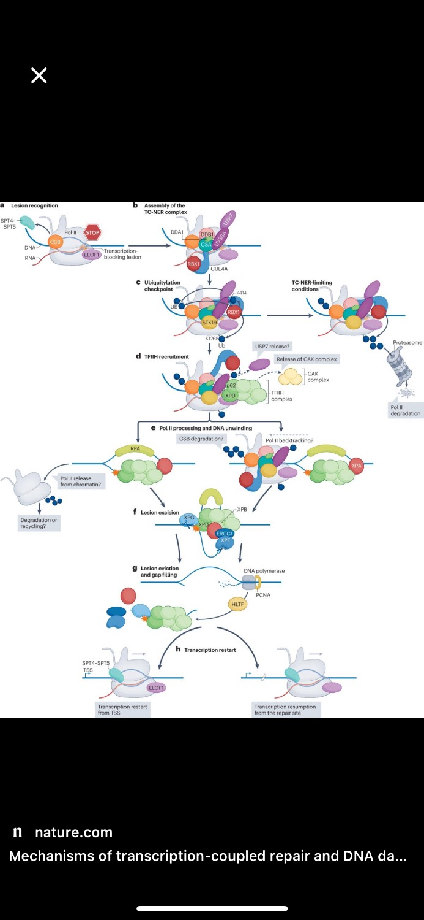

Slide 10

Cockayne Syndrome Protein B (CSB)
CSB is the first protein recruited to the stalled transcription complex.
Functions of CSB
Chromatin remodeling
Stabilization of the repair complex
Recruitment of additional repair factors

Slide 11
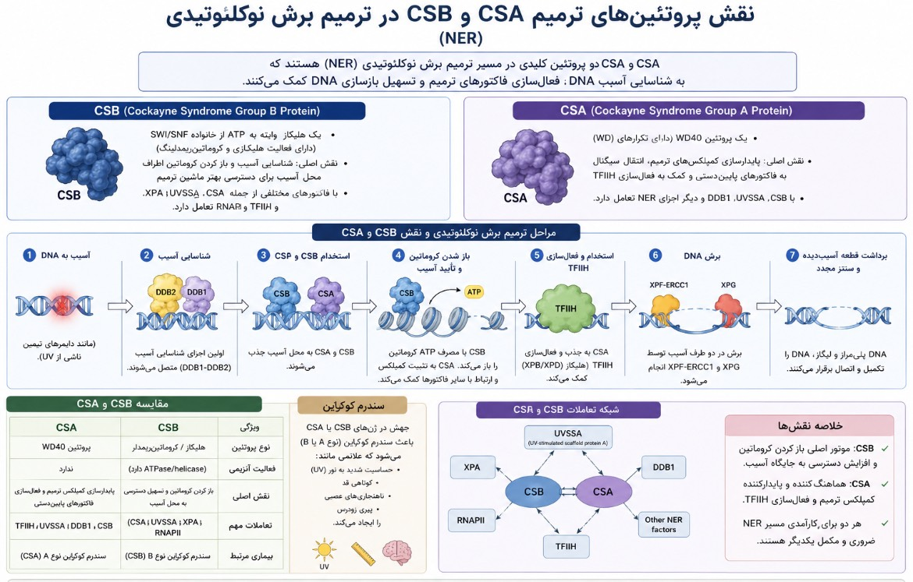
Role of CSA

Slide 12

Cockayne Syndrome Protein A (CSA)
Functions
Regulation of ubiquitination
Assembly of the repair machinery
Control of CSB stability

Slide 13
Role of UVSSA and USP7
Repair-Stabilizing Complex
01
UVSSA
Recruits USP7
.
Venus has extremely high temperatures
03
Outcome
Stabilization of the TC-NER repair complex
02
.
. USP7
Prevents CSB degradation

Slide 14

TFIIH Complex
A critical complex involved in:
Transcription
DNA repair

Slide 15
DNA unwinding
Lesion verification
Preparation for excision
Functions

Slide 16
DNA Excision Step
DNA Resynthesis
Endonucleases
DNA Resynthesis
XPF-ERCC1
XPG
.
Following lesion removal: DNA polymerase δ/ε fills the gap DNA ligase I seals the remaining nick
Function
.
.
Removal of the damaged DNA fragment containing approximately:
25–30 nucleotides
.
.

Slide 17
Complete TC-NER Pathway
Major Steps of TC-NER
RNA Polymerase II stalling
Recruitment of CSB
Recruitment of CSA and UVSSA
Activation of TFIIH
DNA excision
DNA resynthesis
Transcription restart

Slide 18
Role of Ubiquitination
Ubiquitination of RNA Polymerase II
If repair fails:
RNA Polymerase II becomes ubiquitinated The stalled polymerase is degraded by the proteasome

Slide 19
Prevents persistent transcription blockage
Biological Importance

Slide 20
Transcription Stress
Prolonged disruption of transcriptional processes
.
Consequences
Cellular inflammation
Cellular senescence
Apoptosis
Loss of cellular function
Venus has extremely high temperatures
.
.
Stabilization of the TC-NER repair complex

Slide 21
DNA Damage Surveillance
Cells continuously monitor:
Transcriptional integrity
DNA damage formation
Coordination of DNA repair responses

Slide 22
Cockayne Syndrome
UV-Sensitive Syndrome (UVSS)
Caused by defects in:
CSA , CSB
Clinical Features
Premature aging Growth impairment Neurodegeneration UV sensitivity
Characteristics
UV hypersensitivity Defective TC-NER pathway
Difference from Cockayne Syndrome
Absence of severe neurodegeneration

Slide 23
Conclusion
DNA repair systems are essential for maintaining genomic stability and cell survival. Among these pathways, TC-NER plays a major role in protecting actively transcribed genes and preserving normal transcription.
This study shows that RNA Polymerase II acts not only as a transcription enzyme, but also as a direct sensor of DNA damage. When transcription is blocked, several repair responses are activated, including:
Recruitment of repair proteins
Chromatin remodeling
Transcription recovery
The article also highlights that defects in TC-NER and transcription recovery can lead to:
Premature aging
Neurodegeneration
Chronic inflammation
Cancer
Overall, the interaction between transcription, DNA repair, and genome surveillance is critical for cellular health and disease prevention.

Slide 24
Resources
Mechanisms of transcriptioncoupled repair and DNA damage surveillance in health and disease.
)nature reviews molecular cell biology (
)Marjolein van Sluis1,3, Camila Gonzalo-Hansen1,3, Qingrong Li2 , Hannes Lans 1 , Dong Wang 2 & Jurgen A. Marteijn .(
Mechanisms of DNA damage, repair and mutagenesis
HHS Public Access
)Nimrat Chatterjee* and Graham C. Walker Department of Biology, Massachusetts Institute of Technology, Cambridge, MA 02138(

